Slide 1
Gradient Descent and Chaos
Unexpected patterns in optimisation
Dr. Umberto Michelucci
umberto.michelucci@toelt.ai

Slide 2
Problem Statement
Let us consider bi-dimensional inputs
We want to minimise the following loss function (MSE)

Slide 3
Problem Statement
We want to do linear regression

Slide 4
Data
We consider the following input dataset
We consider the following labels

Slide 5
How to solve the problem analytically
Solving the problem analytically is very easy…
The solution is at the point

Slide 6
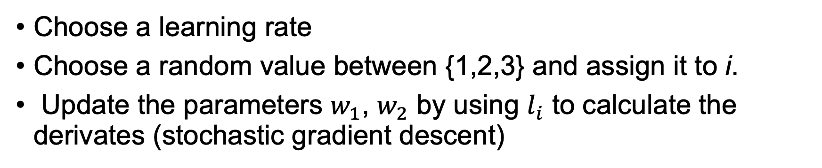
How to solve the problem numerically
Choose a learning rate
Choose a random value between {1,2,3} and assign it to i.
Update the parameters $w_{1}$, $w_{2}$ by using $l_{i}$ to calculate the derivates (stochastic gradient descent)
Go back to the start and iterates for $N$ times

Slide 7
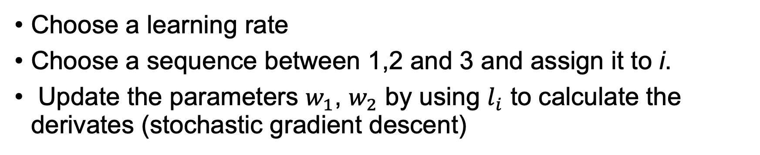
How to solve the problem numerically
Choose a learning rate
Choose a sequence between 1,2 and 3 and assign it to i.
Update the parameters $w_{1}$, $w_{2}$ by using $l_{i}$ to calculate the derivates (stochastic gradient descent)
Go back to the start and iterates for $N$ times

Slide 8
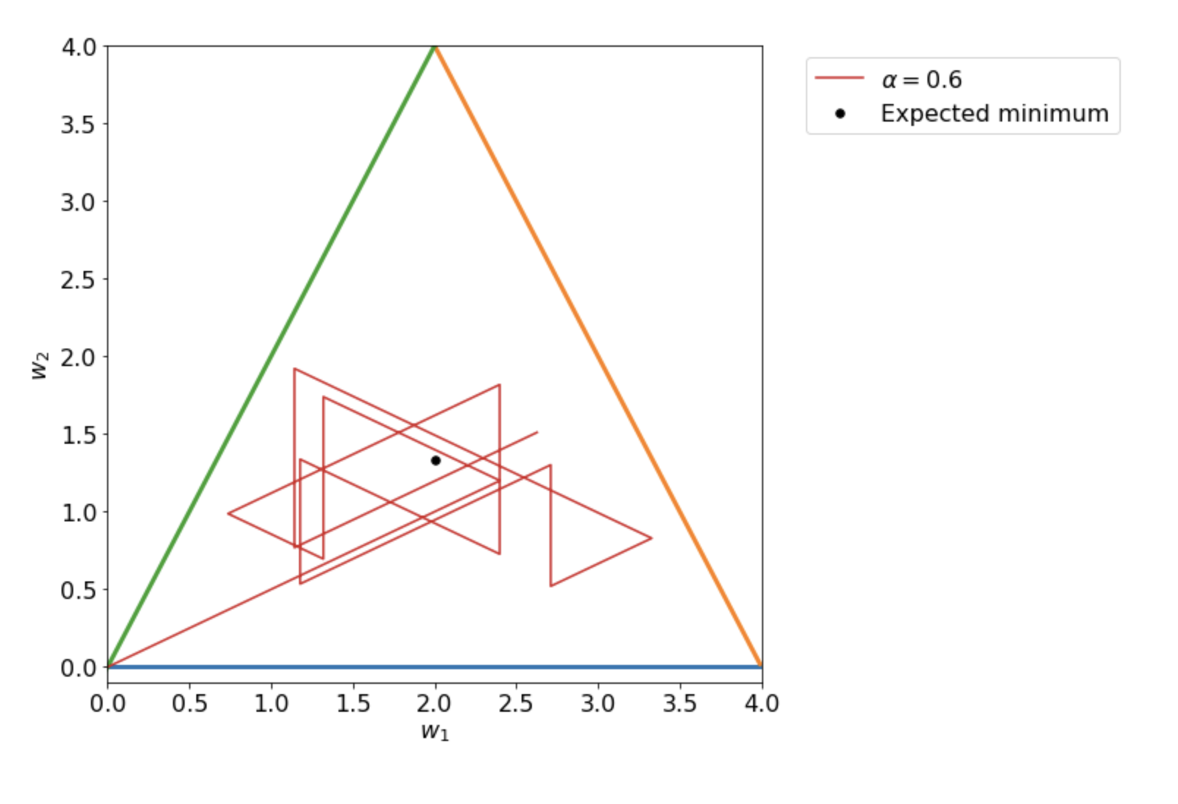
Plot all points of the solution
Michelucci, U. (2022). Applied Deep Learning with TensorFlow 2: Learn to Implement Advanced Deep Learning Techniques with Python. Apress. https://doi.org/10.1007/978-1-4842-8020-1

Slide 9
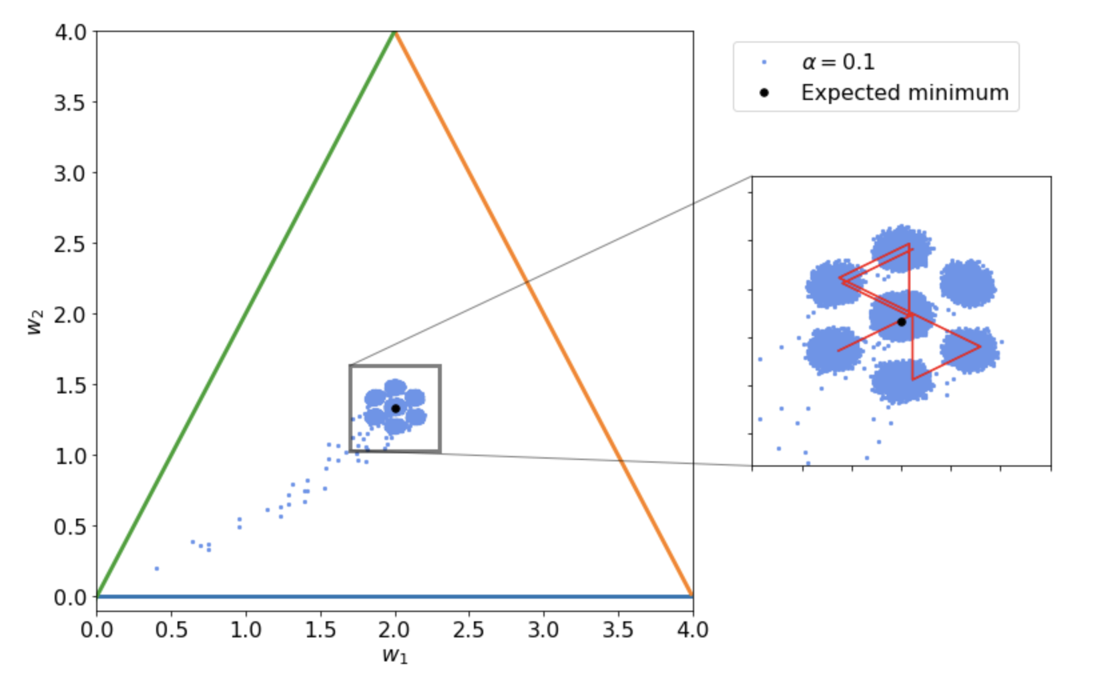
Plot all points of the solution
Michelucci, U. (2022). Applied Deep Learning with TensorFlow 2: Learn to Implement Advanced Deep Learning Techniques with Python. Apress. https://doi.org/10.1007/978-1-4842-8020-1

Slide 10
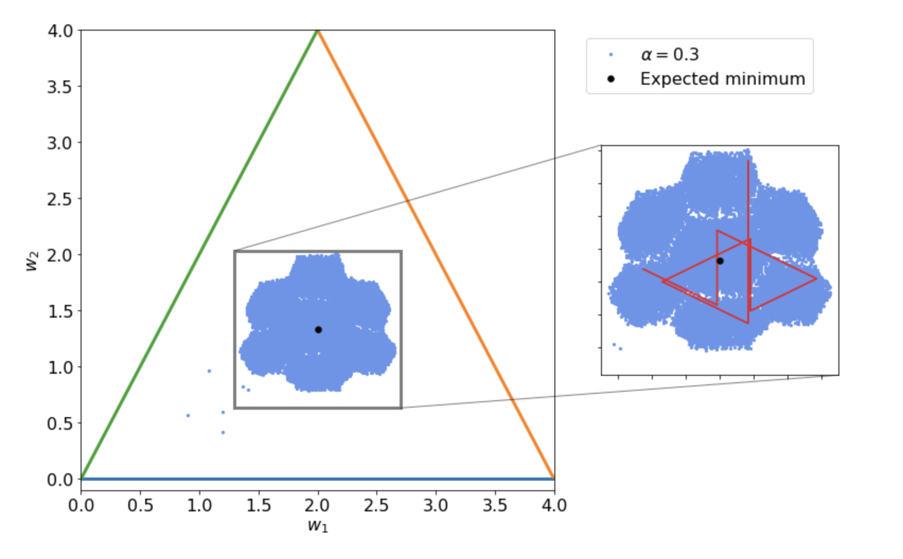
Plot all points of the solution
Michelucci, U. (2022). Applied Deep Learning with TensorFlow 2: Learn to Implement Advanced Deep Learning Techniques with Python. Apress. https://doi.org/10.1007/978-1-4842-8020-1

Slide 11
Now Fractals…

Slide 12
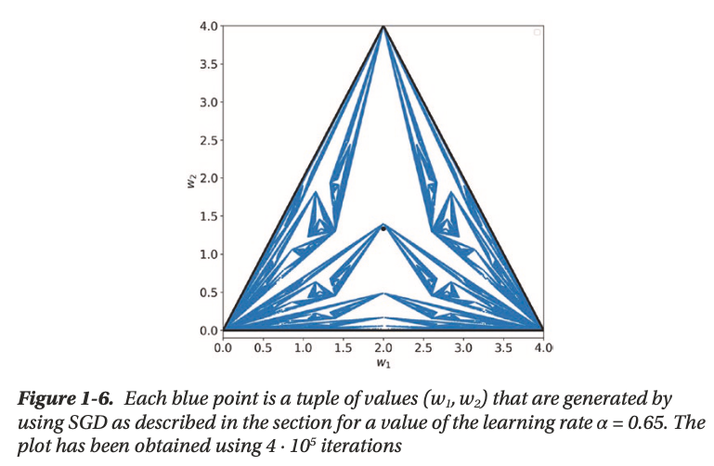
Plot all points of the solution
Michelucci, U. (2022). Applied Deep Learning with TensorFlow 2: Learn to Implement Advanced Deep Learning Techniques with Python. Apress. https://doi.org/10.1007/978-1-4842-8020-1

Slide 13
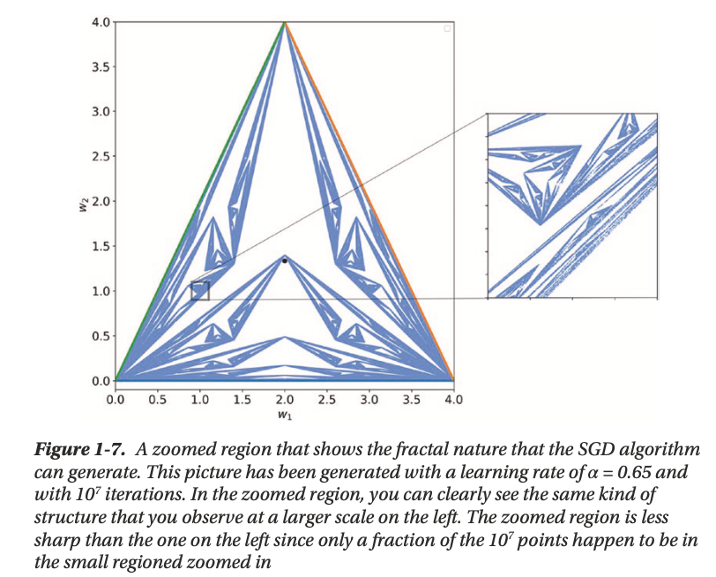
Plot all points of the solution
Michelucci, U. (2022). Applied Deep Learning with TensorFlow 2: Learn to Implement Advanced Deep Learning Techniques with Python. Apress. https://doi.org/10.1007/978-1-4842-8020-1

Slide 14
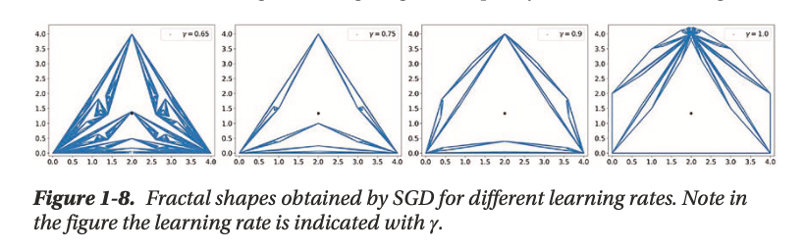
Plot all points of the solution
Michelucci, U. (2022). Applied Deep Learning with TensorFlow 2: Learn to Implement Advanced Deep Learning Techniques with Python. Apress. https://doi.org/10.1007/978-1-4842-8020-1

Slide 15
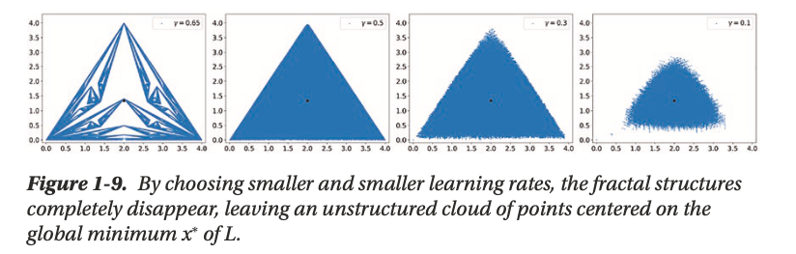
Plot all points of the solution
Michelucci, U. (2022). Applied Deep Learning with TensorFlow 2: Learn to Implement Advanced Deep Learning Techniques with Python. Apress. https://doi.org/10.1007/978-1-4842-8020-1

Slide 16
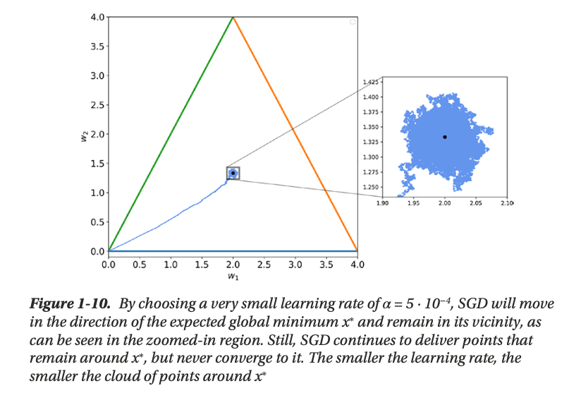
Plot all points of the solution
Michelucci, U. (2022). Applied Deep Learning with TensorFlow 2: Learn to Implement Advanced Deep Learning Techniques with Python. Apress. https://doi.org/10.1007/978-1-4842-8020-1

